Slide 1
Generating Instruction-Response Datasets for Java Code using StarCoder2
Using StarCoder2 & Java from The Stack v2
Buddula Karthik Reddy DS677

Slide 2
Project background
To create a dataset of instruction-response pairs using Java code, which can be used to fine-tune instruction-following models like StarCoder2.
Large Language Models (LLMs) like StarCoder2 become more powerful when trained on instruction-style data. These datasets teach the model how to respond to prompts
We used The Stack v2 — a large collection of real-world code — and focused on the Java programming language.

Slide 3
Project Pipeline Overview
Pipeline Steps:
Seed Gathering Extract real Java code snippets from The Stack v2 dataset.
S → C (Seed to Comment) Generate a natural-language comment describing the code.
C → I (Comment to Instruction) Transform the comment into a clear user-style instruction.
I → R (Instruction to Response) Use a language model (StarCoder2) to generate the correct code response.

Slide 4
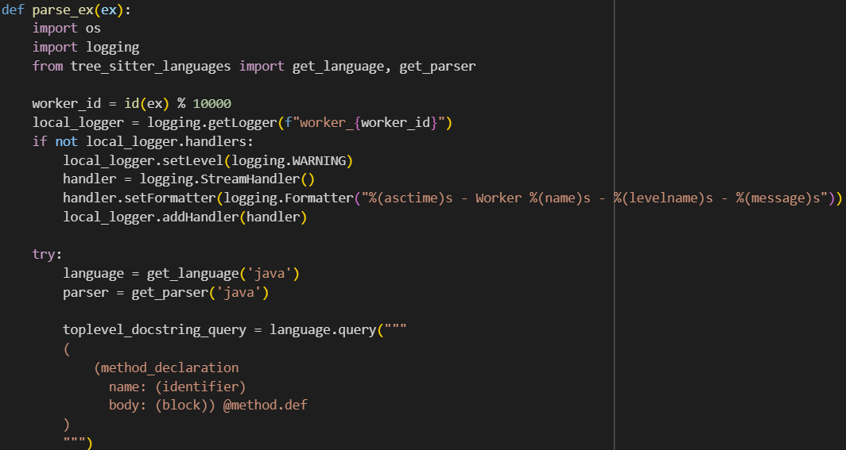
Step-1 Seed Gathering
Initialize Parser for Java
get_language('java'): Loads the parsing rules (grammar) for Java.
get_parser('java'): Creates a Tree-sitter parser for Java source code.

Slide 5
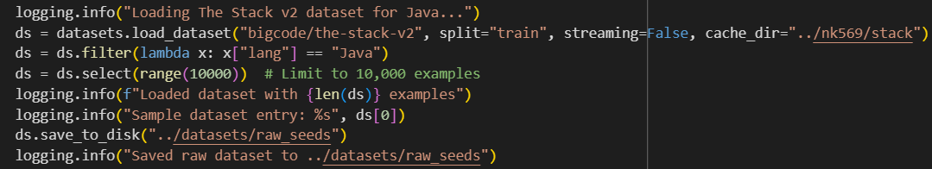
Download and Parse Code from Stack v2 Dataset
Loads the Stack v2 dataset using HuggingFace datasets.
Filters for only Java files.
Selects a small batch (10,000 files) for parsing.
Applies the parse_ex() function to extract Java methods.

Slide 6
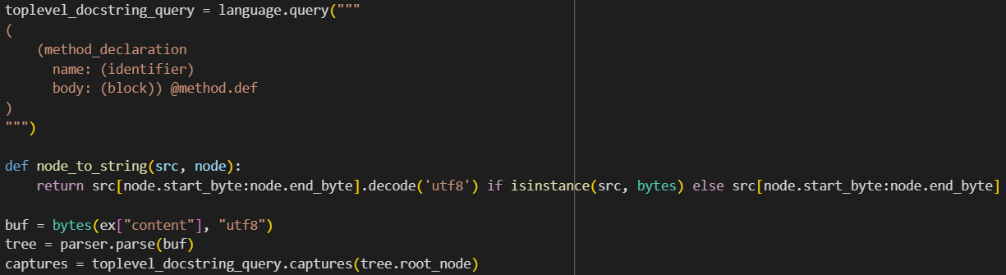
Extract Specific Code Elements
Creates a Tree-sitter query to find method declarations in Java code.
Parses the code into a syntax tree.
Captures each Java method block.

Slide 7
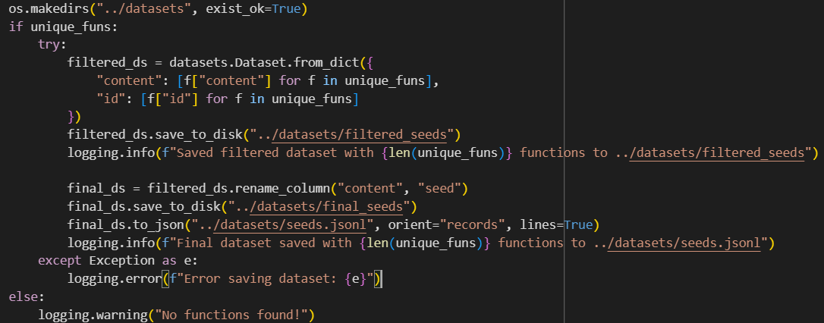
Save Seeds for the Next Step
Filtered and deduplicated the extracted Java methods.
Converted the method content and ID into a structured dataset using HuggingFace Dataset.
Renamed "content" column to "seed" to match required format.
Saved the dataset as a .jsonl file where each line is a single seed.
This file is used as input for the next pipeline steps (comment and instruction generation).

Slide 8
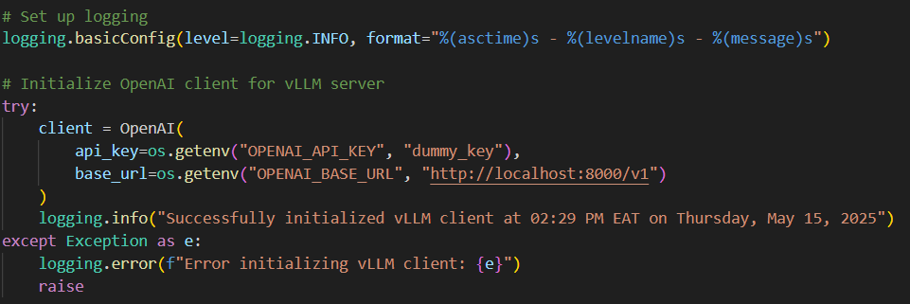
Step-2(Self-OSS-Instruct)
Initialize vLLM Client
This sets up the connection with the vLLM server where StarCoder2 is running. Without this, no generation would happen.

Slide 9
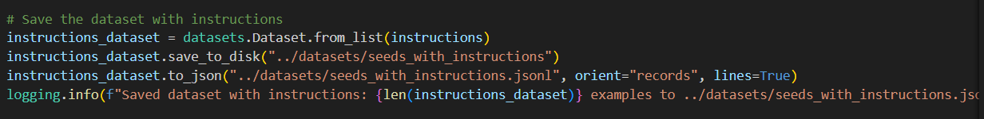
Saving Progress
This saves the final dataset with all seed, comment, and instruction fields into a JSONL file.
we transform code snippets (seeds) into natural-language instructions using the StarCoder2 model hosted on a vLLM server. This involves two sub-steps: first, each seed is passed to the model to generate a brief comment describing what the code does (S→C). Then, that comment is further converted into a full instruction that tells someone what kind of Java code to write (C→I). This step results in a dataset where each entry contains the original seed, a descriptive comment, and a corresponding instruction, which is saved for the next phase.

Slide 10
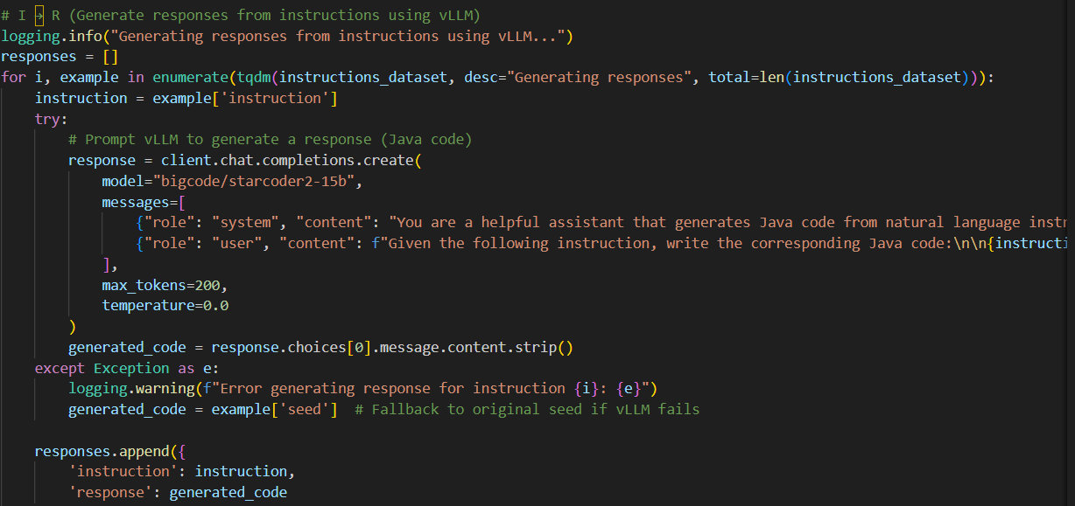
Step-3(Self Validation)
R (Instruction → Response / Java Code)

Slide 11
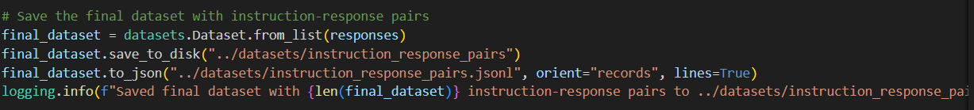
Final Output
In Step 3, known as Self-Validation, the goal is to complete the instruction-response dataset by generating code responses from the natural-language instructions produced in Step 2. This is done using the StarCoder2 model through a vLLM server. For each instruction, the model is prompted to generate the corresponding Java code, which is then saved as the final response. If the model fails, the script defaults to using the original code seed as a fallback. The final output is a dataset of instruction-response pairs, ready to be used for fine-tuning instruction-following models.

Slide 12
Thank You

